Slide 2
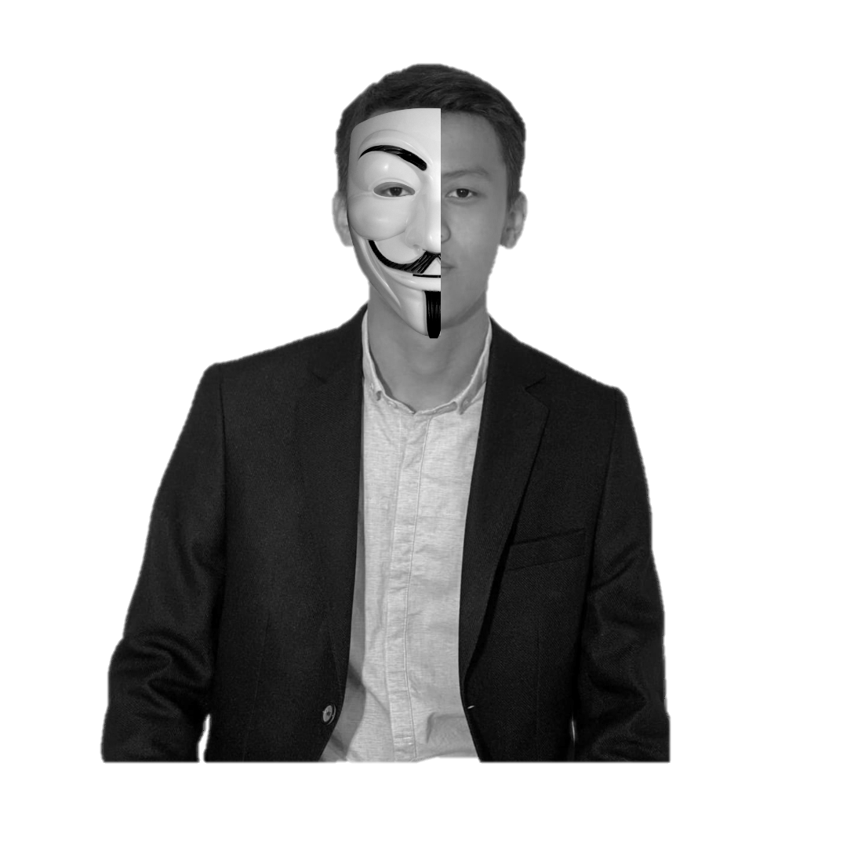

spoof
real
A real-time approach to face spoofing detection
using deep learning
Done by: Iskakov Yerassyl
Supervisor: prof. T.K. Zhukabayeva

Slide 3

Table of contents
Abstract
Introduction
Project Overview
Methodology
Dataset
Model Architecture
Training
Results
Challenges and Solutions
Conclusion

Slide 4
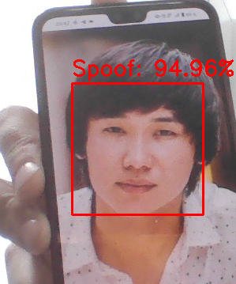
Abstract
Face spoofing attacks, where fake faces (e.g., photos, videos, or masks) are used to bypass authentication systems, pose a significant security threat. This project develops a real-time face anti-spoofing system using deep learning to distinguish between real and spoofed faces. The system ensures robust, accurate, and efficient detection, enhancing security in applications like biometric authentication etc.
Fig 1. Face anti-spoof detection system result

Slide 5

Introduction

Slide 6
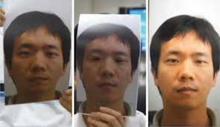
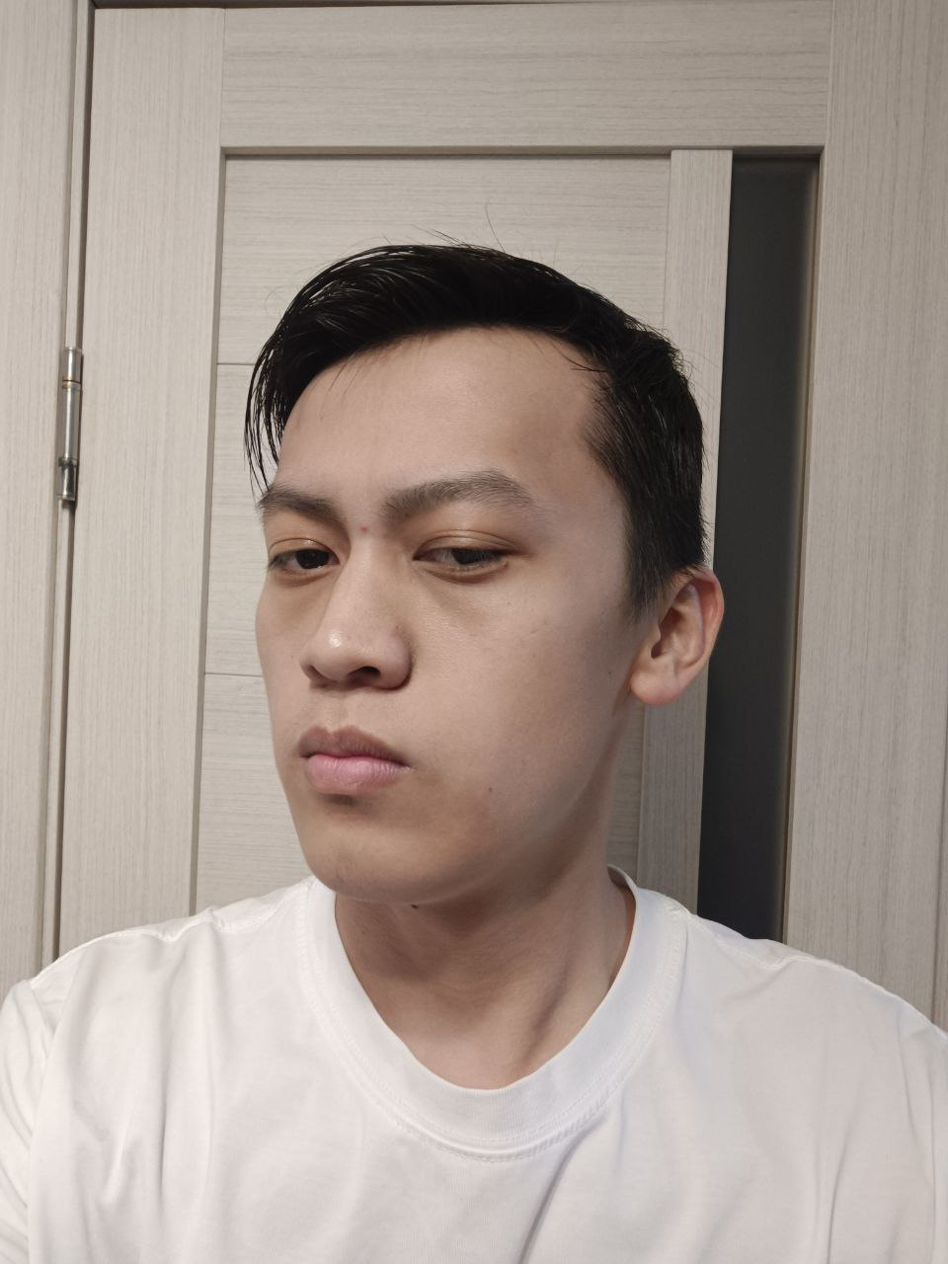
What is presentation attack?
Can computers distinguish between them?
-Yes
This is spoof
Real
A spoof face refers to a fraud attempt to deceive facial recognition systems by presenting fake biometric data, such as photographs, videos, masks, or 3D models, instead of a live, genuine face.

Slide 7
Project Overview

Slide 8

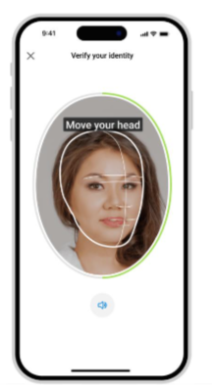


Develop a real-time face anti-spoofing system to detect and prevent spoofing attacks using deep learning and computer vision.
Goal
Include feature
Process live video feed to instantly classify faces as "Real" or "Spoof."
Achieve high accuracy using.
Where can be used?
Biometric authentication.
Surveillance systems for security.
Example: Kaspi app

Slide 9
Methodology

Slide 10
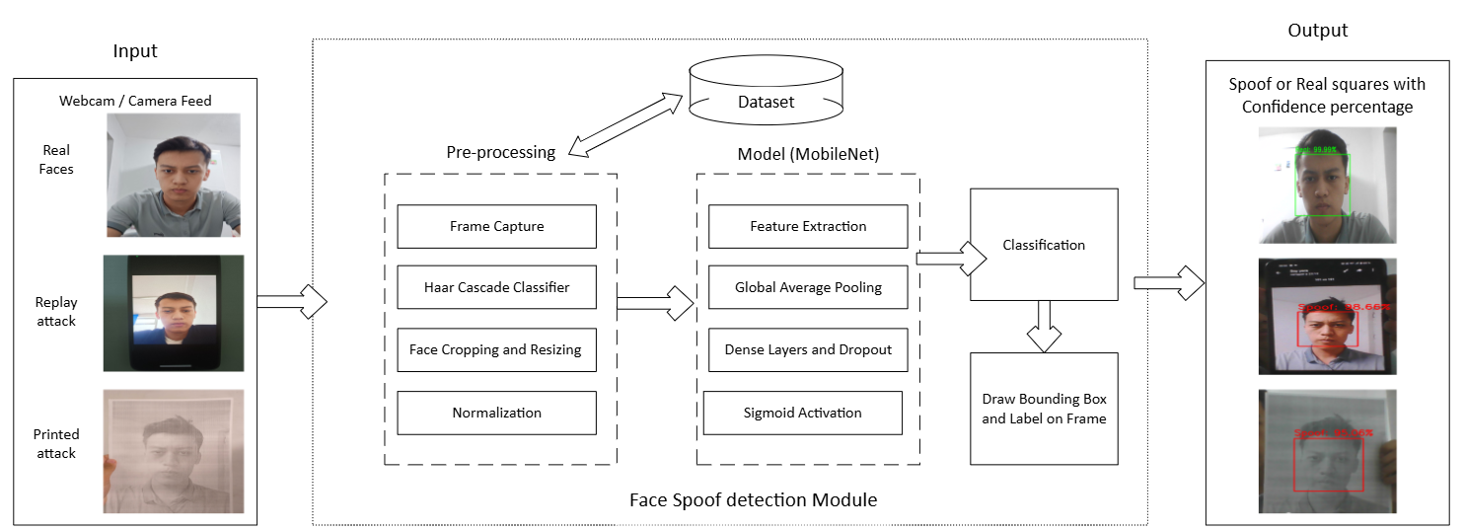
Model Architecture
Fig 1. Block diagram for face spoof detection system.

Slide 11

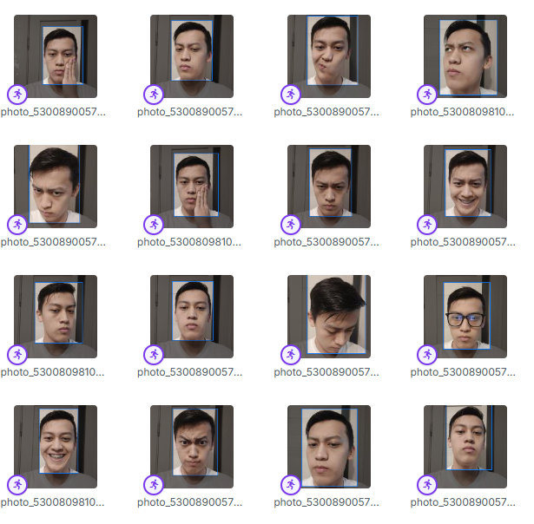
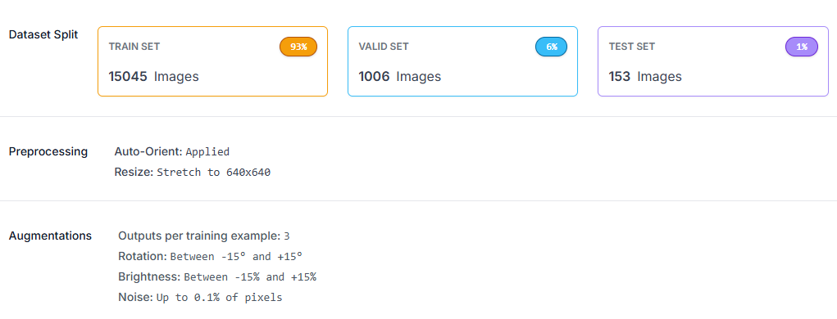
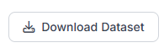
Dataset
🔄
💡
🔊
From 6000 image we got 16k with Roboflow

Slide 12
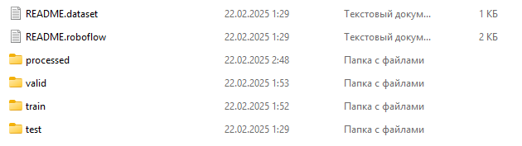
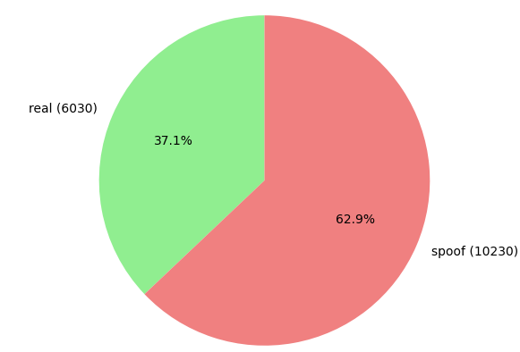
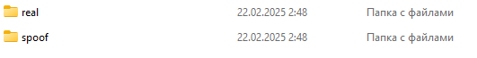
Dataset
def extract_faces_from_folder(folder_path, target_folder): annotations = load_annotations(folder_path) if annotations is None: return 0, 0 real_dir = os.path.join(target_folder, 'real') spoof_dir = os.path.join(target_folder, 'spoof') os.makedirs(real_dir, exist_ok=True) os.makedirs(spoof_dir, exist_ok=True) real_count = 0 spoof_count = 0

Slide 13




Model Architecture
What libraries we employed.

Slide 14
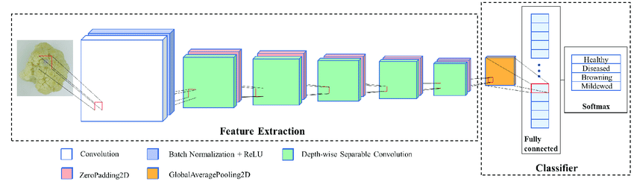
Deep about Model
MobileNet.
Note: DOI: 10.3390/foods11182915

Slide 15
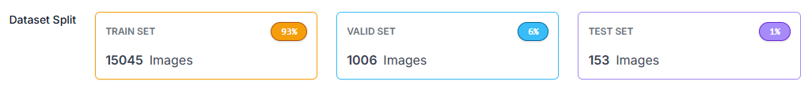
Training
The training was performed over 20 epochs with a batch size of 32, using the Adam optimizer (learning rate of 0.0001) and class weights to address imbalance,

Slide 16
Results

Slide 17
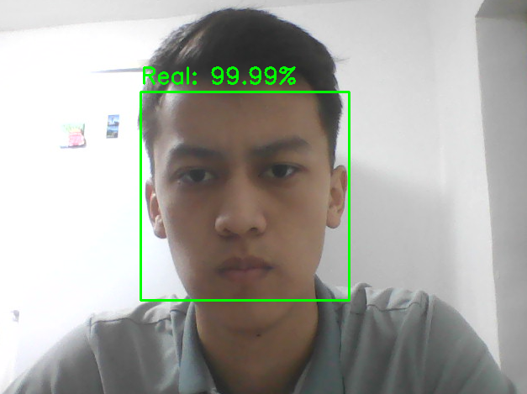
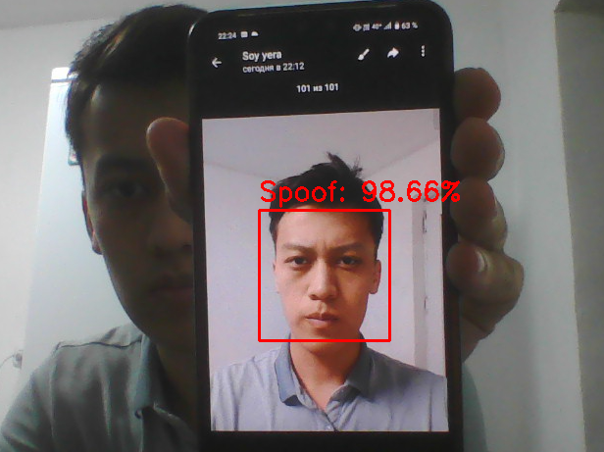
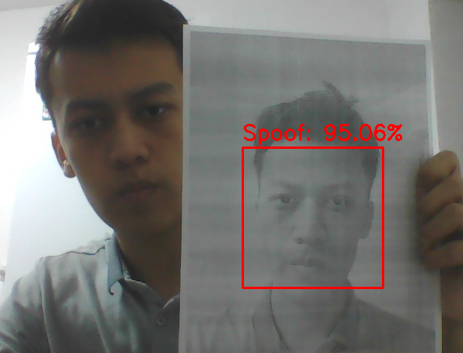
High accuracy 0,98
Real person
Replay spoofing
Print spoofing

Slide 18
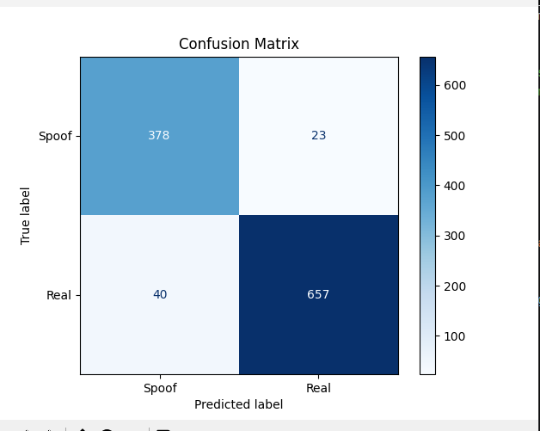
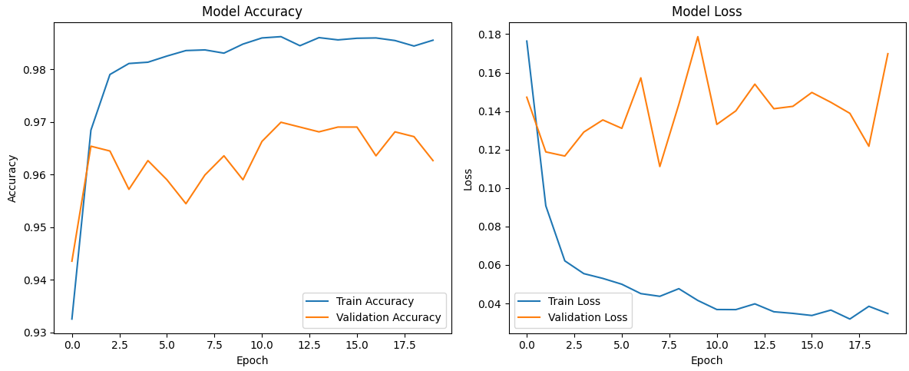
High accuracy
Fig 1. Confusion matrix illustrating the classification performance of model on the validation set
Fig 2. Graph of training and validation loss/accuracy changed over epochs.

Slide 19
Challenges and Solutions

Slide 20
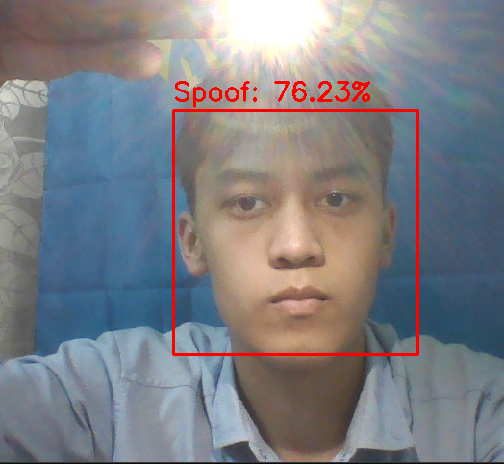

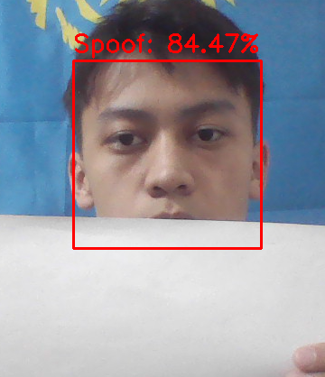
Limitations
Varying lighting conditions affect detection accuracy
Face angles and poses
Can't detect if some part of face is missing
The model struggle with unseen spoofing techniques
Dataset limit (16k)

Slide 21
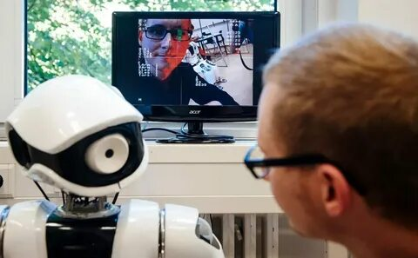

Conclusion
In this project, Real-Time face anti-spoofing system to detect and prevent spoofing attacks using deep learning and computer vision techniques was developed.
By using MobileNet for feature extraction and OpenCV for real-time face detection, the system achieved high accuracy in distinguishing between real and spoofed faces 0,988%. Literature review was conducted.
This project helped me understand the importance of handling imbalanced data, optimizing model performance, and integrating AI into real-world applications.

Slide 22
Thanks for attention!

Slide 23
References
1. Ming, Z., Visani, M., Luqman, M. M., & Burie, J.-C. (2020). A Survey on Anti-Spoofing Methods for Facial Recognition with RGB Cameras of Generic Consumer Devices. Journal of Imaging, 6(12), 139. https://doi.org/10.3390/jimaging6120139
2. [Dataset] Roboflow. URL: https://universe.roboflow.com/enu/face-antispoof-project
3. P. Anthony, B. Ay and G. Aydin, "A Review of Face Anti-spoofing Methods for Face Recognition Systems," 2021 International Conference on INnovations in Intelligent SysTems and Applications (INISTA), Kocaeli, Turkey, 2021, pp. 1-9, doi: 10.1109/INISTA52262.2021.9548404.
4. Y. Atoum, Y. Liu, A. Jourabloo and X. Liu, "Face anti-spoofing using patch and depth-based CNNs," 2017 IEEE International Joint Conference on B
5. Nan, Y., Ju, J., Hua, Q., Zhang, H., & Wang, B. (2022). A-MobileNet: An approach of facial expression recognition. Alexandria Engineering Journal, 61(6), 4435-4444.
6. Rahman, M. H., Jannat, M. K. A., Islam, M. S., Grossi, G., Bursic, S., & Aktaruzzaman, M. (2023). Real-time face mask position recognition system based on MobileNet model. Smart health, 28, 100382.
7. Grünenberg, K. (2022). Wearing someone else’s face: Biometric technologies, anti-spoofing and the Fear of the Unknown. Ethnos, 87(2), 223-240.
8.

